Slide 1


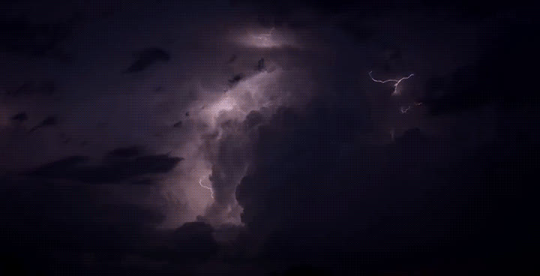
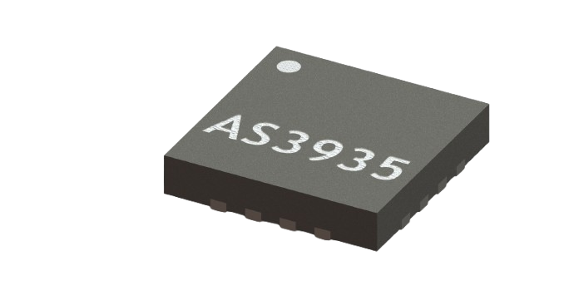
STRATUS
Lightning
Detection
System
Real-Time Atmospheric Intelligence

Slide 2
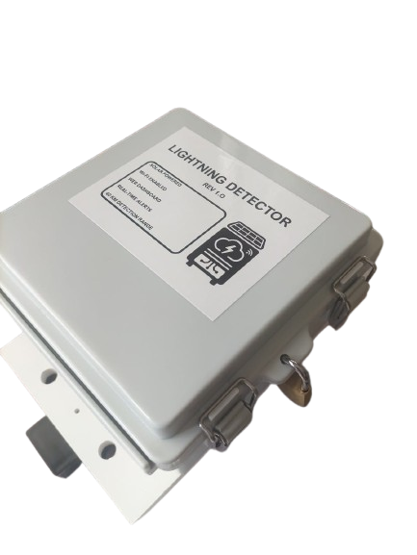
INTRODUCTION
  A standalone, solar-powered lightning detection system sending data to a cloud platform with configurable alerts in real-time

Slide 3
WHY LIGHTING DETECTION IS CRITICAL
• Equipment damage, personnel injury, and operational downtime
• Mining and industrial operations face elevated risk exposure
• Early warning enables proactive evacuation and equipment protection
• Regulatory compliance and safety management requirements
• ROI: Prevention costs vs. incident costs (damage, injury, downtime)

Slide 4
LDS TECHNICAL SPECS
• Continuous 24/7 detection up to 40 km range
• 14-level storm distance estimation (1 to 40 km)
• Cloud-to-ground and intra-cloud detection
• Configurable EMI rejection for high-noise industrial sites
• Solar-powered with lithium-ion battery reserve
• Real-time cloud dashboard
• Configurable proximity alerts

Slide 5
AS3935
Maximum detection range: 40 km
Distance estimation: 14 discrete levels plus out-of-range
Reported distances (km):
1, 5, 6, 8, 10, 12, 14, 17, 20, 24, 27, 31, 34, 37, 40
Distance accuracy: approximately ±4 km (manufacturer rated)
Detection types: cloud-to-ground and intra-cloud
Lightning energy: 21-bit relative measurement per event
Antenna frequency: 500 kHz (about ±3.5%)
Noise floor levels: 0–7 (programmable)
Minimum strike threshold: selectable 1, 5, 9, or 16 events
Event latency: under 2 seconds (detection to log)

Slide 6
SYSTEM HARDWARE AND CONNECTIVITY
Controller: Quad-core ARM Cortex-A53 SBC
Sensor Interface: SPI Mode 1, 1 MHz
Lightning Sensor: AS3935 (ScioSense)
Connectivity: 2.4 GHz 802.11 b/g/n Wi-Fi
Solar: 6–24 V DC input
Charge Controller: MPPT (Maximum Power Point Tracking)
Battery: 3× 18650 Li-ion parallel
Protection: Over-charge, over-discharge, over-temperature
Minimum recommended panel: 5 W
System is energy-positive with 4–6 peak sun hours per day
Compatible with existing solar infrastructure or dedicated panel

Slide 7
ENCLOSURE AND MOUNTING OF UNIT
Material: ABS plastic (non-metallic, RF transparent)
External Dimensions: 150 × 150 × 89 mm (5.9″ × 5.9″ × 3.5″)
Ingress Protection: IP67 (dust-tight, short-term submersion)
Seal: Silicone gasket
Closure: Stainless steel hinged latches
Cable Entry: PG9 IP68-rated cable glands (bottom entry)
Mounting: Back mounting plate with 2 U-Bolts
Mast Fit: 30–50 mm diameter (U-Bolts with V-Blocks)

Slide 8
LDS CALIBRATION
The lightning sensor has an internal antenna that must be tuned to exactly 500 kHz frequency (like tuning a radio to the correct station).
Proper tuning ensures accurate lightning detection and prevents false alarms.
Calibration happens automatically every 12 hours (configurable)
Temperature change of 10°C triggers immediate recalibration
No technician visits required for routine calibration
No user action needed - system manages itself
Takes less than 5 seconds (does not interrupt detection)

Slide 9
LDS INSTALLATION REQUIREMENTS
  Weather station mast or mounting pole (30-50 mm diameter)
  Clear sky exposure (no overhead metallic structures above sensor)
  Minimum 10 m from large metal objects
  Height: 3-6m above ground level (optimal detection range)
  2.4 GHz Wi-Fi coverage at installation point
  Power option 1: Solar panel (6-24 V DC, minimum 10W)
  Power option 2: Existing solar infrastructure
  Power option 3: AC/DC Adapter (220VAC Supply)

Slide 10


REAL-TIME CLOUD DASHBOARD
• Protocol: HTTPS POST (JSON payload)
• Encryption: TLS 1.2+ end-to-end
• Authentication: API key per station
• Dashboard: Real-time web-based visualisation
• Live strike events with distance and energy
• Historical data analysis and trends
• System health monitoring
• Admin Panel with configurable alerts and user management

Slide 11
MULTI-CHANNEL ALERT DISTRIBUTION
• Default Alert Distance: 10 km (configurable 1 to 40 km)
• Cooldown Period: 60 minutes (configurable)
• Channels: SMS, WhatsApp, Email
• Multiple Recipients: Yes (configurable per channel)
• Content: Distance, energy, timestamp, station ID

Slide 12
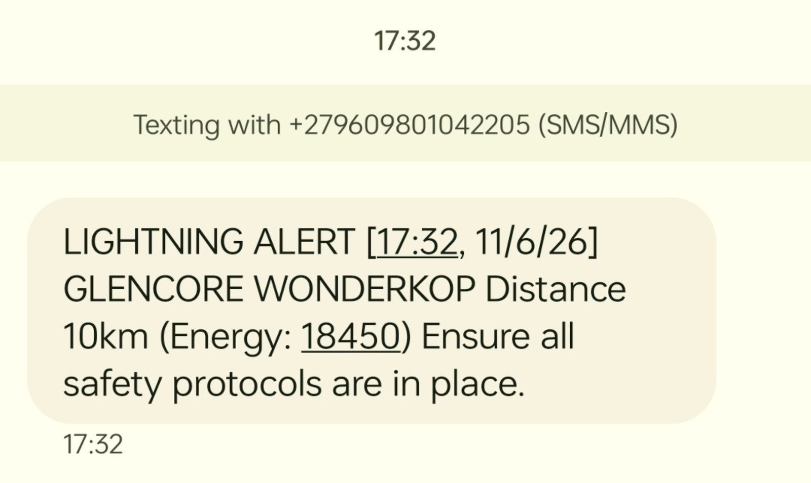
SMS ALERT EXAMPLE
DATE+TIME THE ALERT
WAS TRIGGERED
LOCATION
DISTANCE OF LIGHTNING
ACTIVITY DETECTED

Slide 13
COMPREHENSIVE LIGHTNING REPORTS
Automated reports distributed via email (weekly or monthly)
Reports Include:
• Total lightning events in period
• Closest approach distance
• Energy statistics (min/max/average)
• System uptime percentage
• Formatted PDF attachment with charts and graphs

Slide 14
CALIBRATION PROCESS & REPORTS
Automatic Calibration:
• Checked every 12 hours, also triggered by 10°C delta.
• Frequency verification: 500 kHz (+/- 3.5%).
On-Site Commissioning:
• Verification of resonance and EMI noise profiling.
Monthly Verification Reports:
• System health status, register checks, CPU temp log, and strike counts.

Slide 15
WHAT IS THE LIFESPAN OF THE SENSOR?
Sensor Lifespan:
• AS3935 sensor chip: 20+ year design life (solid-state)
• Processor: 5 to 10 years typical operational life
• Lithium-ion battery pack: 3 to 5 years (easily replaceable)
• Enclosure and mounting hardware: 10+ years
Expected System Lifecycle:
• Primary deployment: 5 to 7 years
• Battery replacement cycle: Every 3 to 5 years

Slide 16
HOW DO WE KNOW WHEN IT IS OFFLINE?
Multi-Layer Monitoring System:
1. Heartbeat Reporting: Periodic heartbeat to cloud (every 30 minutes).
2. Dashboard Status Indicators: Real-time Online/Offline status.
3. SMS Alert / Email alert sent to personnel
Optional Indicators (add-ons):
1.Beacon Visual Indicator: GREEN light (online), RED light (offline/fault)
(Can include a buzzer as well)

Slide 17
LDS WARRANTY
The LDS carries a 1-year warranty, excluding damage from lightning, surge, and weather-related events.
If the unit is damaged and requires repair or replacement, and it is still within the warranty period, we will repair or replace the unit at no charge.
However, this excludes the callout cost of the technician required to visit the site, perform troubleshooting, and replace the unit if necessary
(this cost will be for the client's account)

Slide 18
MEASURES TO PREVENT DOWNTIME
Proactive Monitoring:
• Automated health checks
• Predictive alerts
• Remote diagnostics capability
Redundant Communication:
• Offline data buffering (stores events locally if Wi-Fi drops)
• Automatic retry and sync when connection restored
Other Features:
• Watchdog timer (auto-restart)
• Automatic recalibration on temperature changes
• Daily register verification (detects sensor faults)

Slide 19
CYBERSECURITY & DATA PROTECTION
1. Communication Security:
TLS 1.2+ encryption, API key authentication.
2. Data Integrity:
JSON payload signing (HMAC-SHA256).
3. Access Control:
Role-based dashboard with bcrypt password hashing.
4. Unauthorized Access Prevention:
Outbound-only firewall rules, disabled SSH.

Slide 20
CYBERSECURITY & DATA PROTECTION
5. Data Privacy:
Hosted in South Africa (POPIA compliant).
6. Vulnerability Management:
CVE monitoring, regular security audits.

Slide 21
CYBERSECURITY THREAT MANAGEMENT
Automatic security updates (system packages)
Firmware update mechanism with digital signature verification
Intrusion detection: Abnormal network activity monitoring
Logging: All authentication attempts, configuration changes logged
Security incident response plan
Quarterly security audits
CVE monitoring for all software components

Slide 22
Thank you for your time

